Slide 1

Why R?
Derek H. Ogle
Northland College

Slide 2
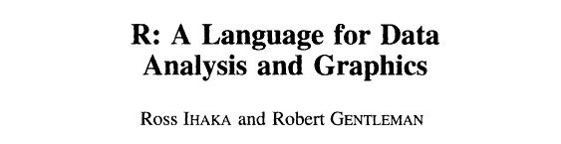

The Name
The original publication ….
Journal of Computational and Graphical Statistics, 5:299-314. 1996

Slide 3
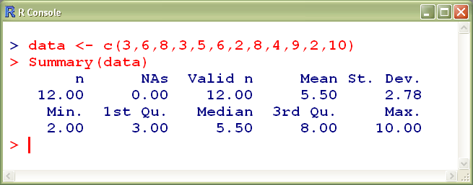
The R Introduction* says …
R is a language and environment for statistical computing and graphics.
That means …
  typing … not pointing-and-clicking
* www.r-project.org

Slide 4
The R Introduction says …
R is a language and environment for statistical computing and graphics.
But it means so much more …
  Data handling, manipulation, and storage.
  Large number of statistical analyses.
    Basic statistics, linear models, non-linear models, time series analysis, clustering, classification, …
  A well-developed programming language which includes conditionals, loops, and user-defined functions.
  Publication-quality graphics.

Slide 5
The R Introduction says …
R is a language and environment for statistical computing and graphics.
But it means so much more …
  High-level graphics.
    Publication-quality.
    Complete control.
    User-defined.
    Interactive.

Slide 6
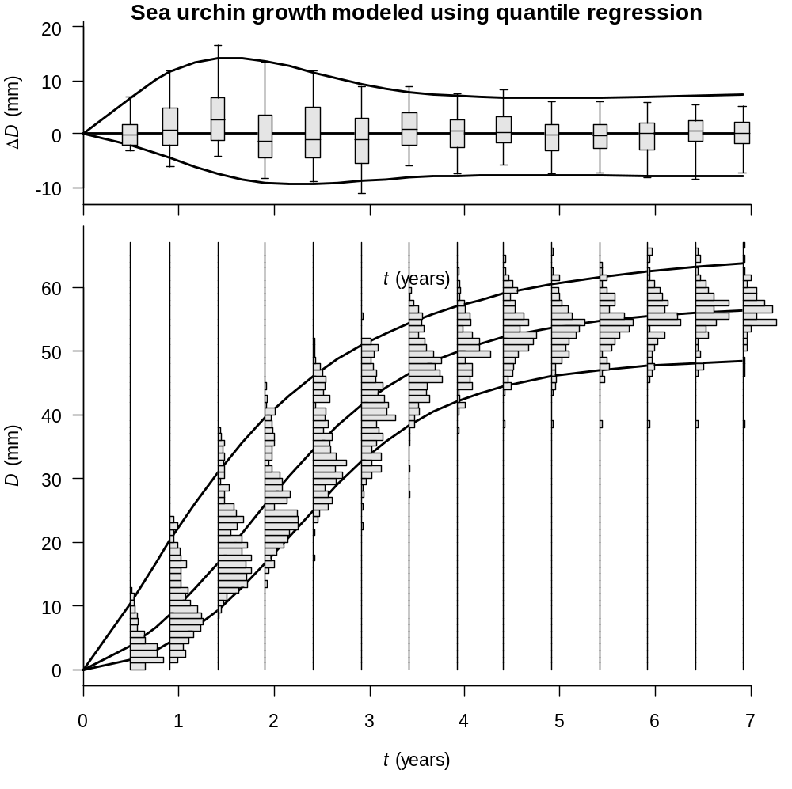
from Grosjean, PH, Ch. Spirlet & M. Jangoux, 2003. A functional growth model with intraspecific competition applied to a sea urchin, Paracentrotus lividus. Can. J. Fish. Aquat. Sci., 60:237-246.

Slide 7
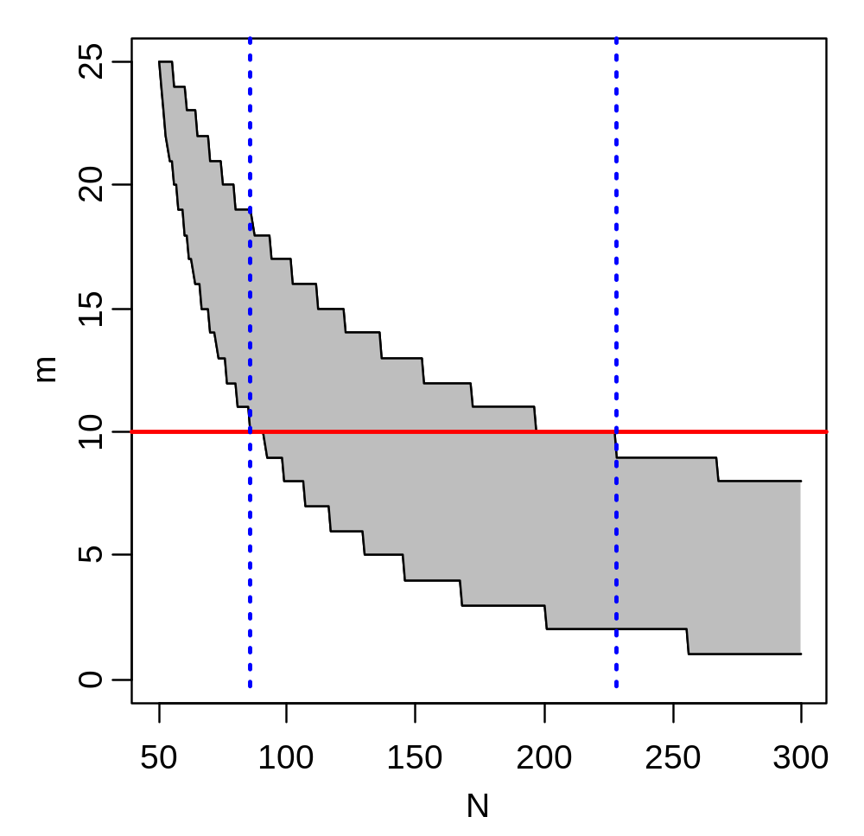

Slide 8
The R Introduction says …
R is a language and environment for statistical computing and graphics.
But it means so much more …
  Method for producing reproducible research.
  Extensible through packages.

Slide 9
R Package Concept
Automatic Packages
base
stats
utils
graphics
datasets
Methods
grDevices
CRAN Available PKGs
alr3
boot
Design
iplots
.
~1300 more (on 15Feb08)
.
R Core
Local Packages
NCStats
FSAdata
FSA
.
(your package here)
.

Slide 10
R is Open Source
Free (and multi-platform).
Continuously developed by a large group of international researchers.
Imperceptible time-lag for new methods.
  e.g., I implemented Isermann and Knight’s age-length key method within one month of publication
No “black boxes”.

Slide 11
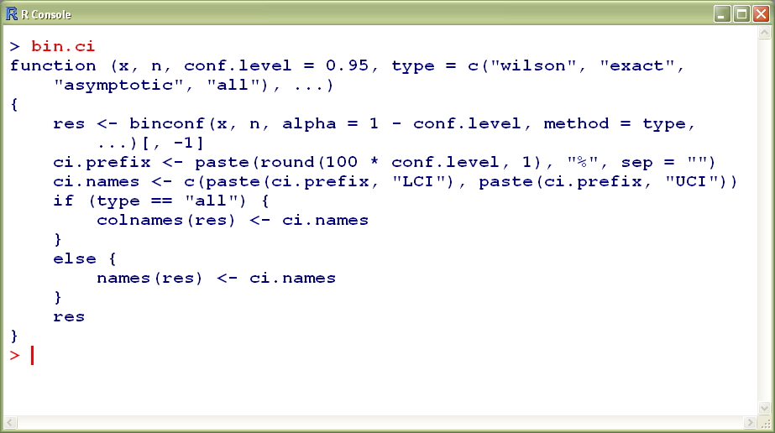
R is Open Source
No “black boxes”.

Slide 12
So, Why R for Fisheries Work?
Extremely powerful.
Publication-quality graphics.
Reproducible research.
Near real-time development.
Fast becoming the standard “tool” for statistics.
Free.

